Slide 1
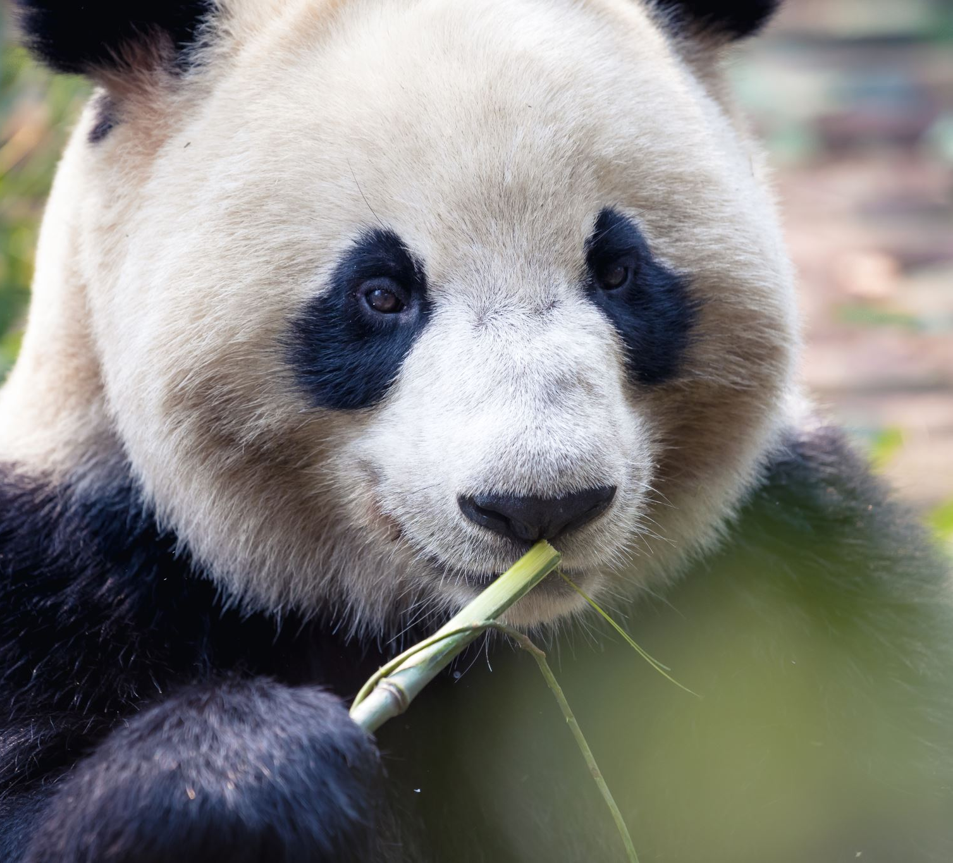
Team Panda
Final Iteration
Peiyang Chang && Yanjie Ning

Slide 2
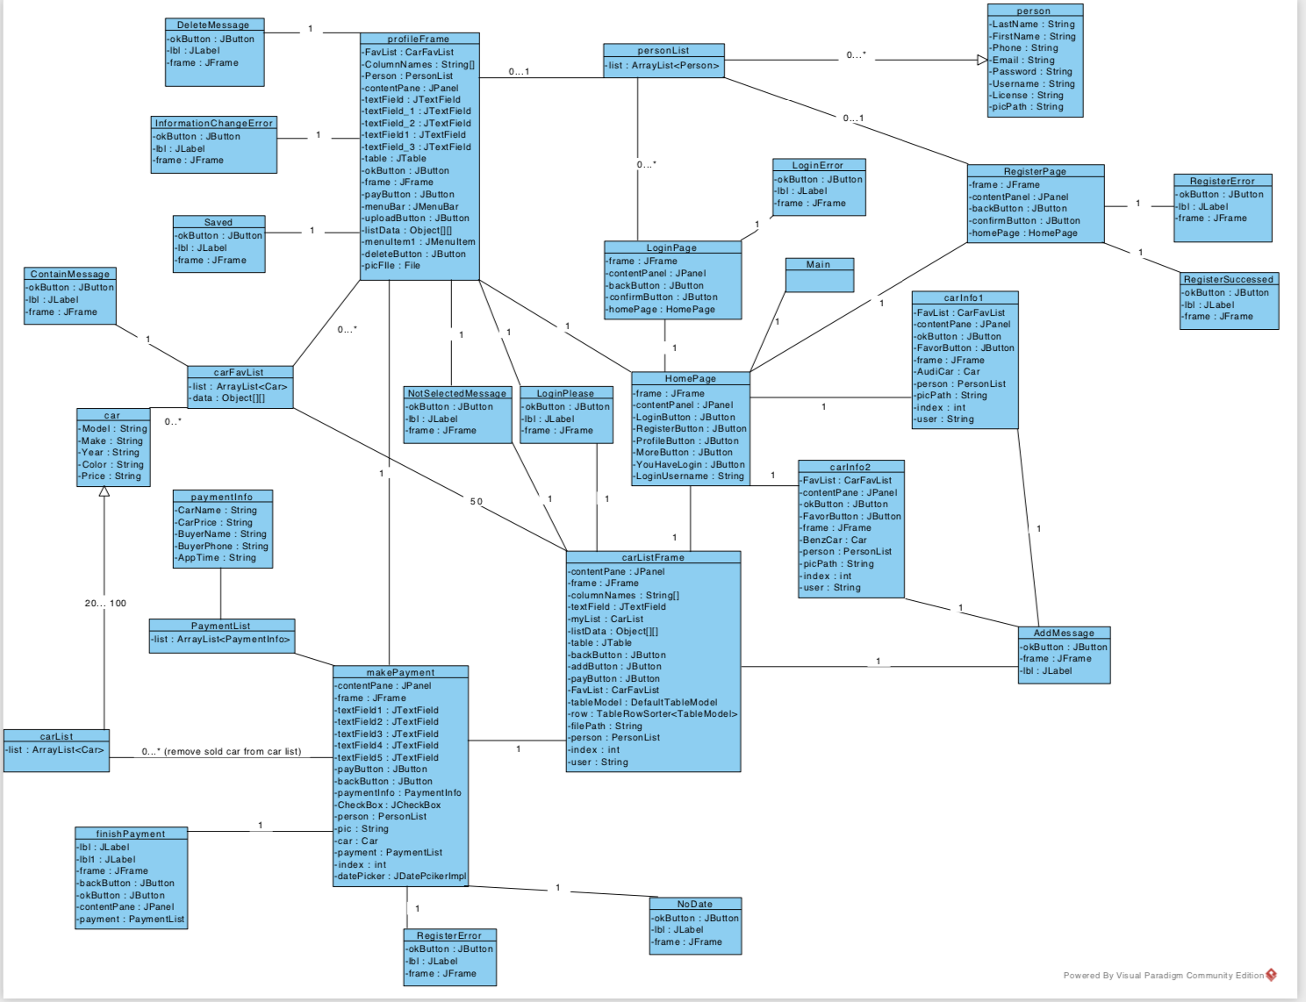
Domain Model

Slide 3
Car Dealership
This is Team Panda which is a small software development team from Software Engineering CSI 3471 class. Our project’s goal is to be the best car dealership in Waco and let all the Baylor students get what car they want! In out dealership, we have all kinds of cars that fit for different people.
All you need to do is register an account and login, then you could check all the cars we have and find out which one is best for you!
Easy to take a look, and no lots of paperwork need to fill. Feel free to ask if you have any questions, the email is peiyang_chang1@baylor.edu

Slide 4
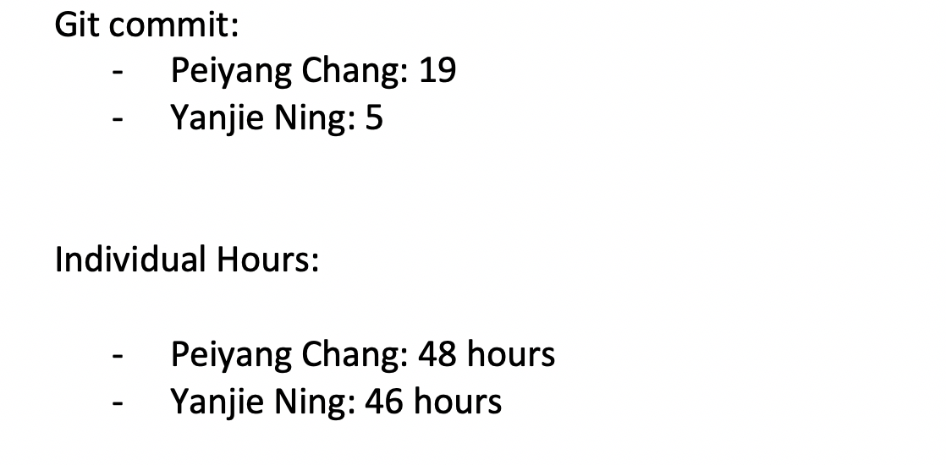

Slide 5
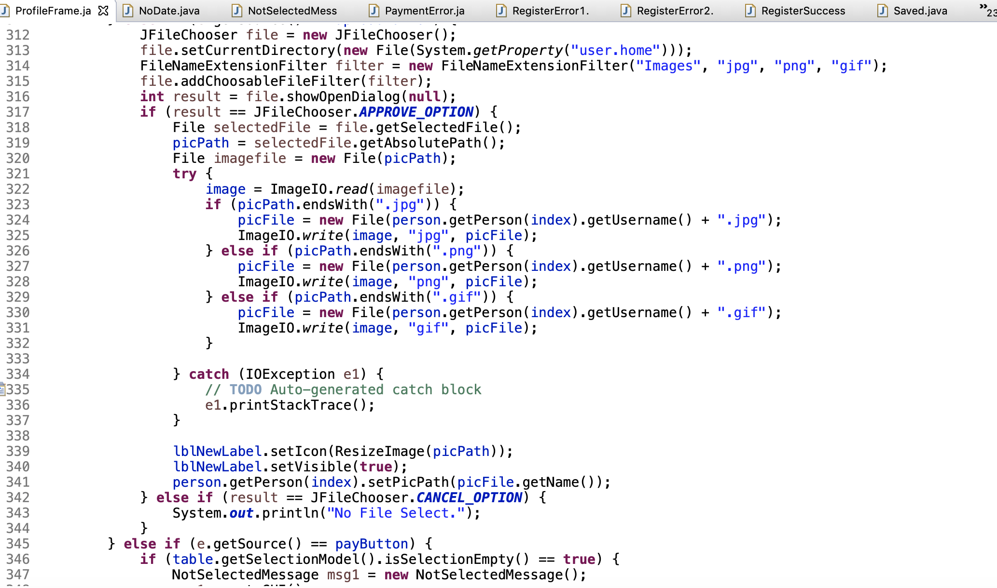
3900 lines of code

Slide 6
Let’s take a look at the project!

Slide 7
Register condition
1. Last Name can not be empty
2. First Name can not be empty
3. Email has to be Baylor Email
4. Phone has to be 11 digits
5. Password has to be matched
6. Username has to be unique
7. License number has to be 8 digits

